Slide 1
Severity Detection of Chronic Fatigue Syndrome using ML Models
By: Sarah Thomas (EAC23049)
Samvrudha RR (EAC23052)
Sashank Abburu (EAC23053)
T Pushkar Reddy (EAC23057)
Batch 12

Slide 2
Introduction
Chronic Fatigue Syndrome (CFS), also known as Myalgic Encephalomyelitis (ME), is a serious, long-term illness characterized by extreme fatigue that isn’t improved by rest and worsens with physical or mental activity. Unlike ordinary tiredness, CFS reflects a complex disruption across the immune, neurological, and metabolic systems.
With over 20 years of research backing, CFS is now recognized by the CDC, NIH, and WHO as a medically and socially impactful disorder. Core symptoms include post-exertional malaise (PEM), cognitive dysfunction ("brain fog"), unrefreshing sleep, pain, and orthostatic intolerance. The condition varies in severity—from mild to disabling—and lacks definitive biomarkers, making early diagnosis and management challenging.
Globally, it affects around 0.2% to 0.8% of the population and significantly impacts quality of life and productivity. Recent advances in machine learning and biomedical data analysis are paving the way for more accurate severity prediction, early detection, and personalized care strategies.

Slide 3
Problem Statement
Chronic Fatigue Syndrome (CFS) lacks objective tools for assessing severity, leading to inconsistent and delayed care. This project leverages machine learning to predict CFS severity from patient symptom data, aiming to support faster, more reliable clinical decision-making.

Slide 4
Literature Survey
Objective: The study applies various machine learning (ML) models to detect and predict the severity of Chronic Fatigue Syndrome (CFS), aiming to support early diagnosis and treatment planning.
ML Models Reviewed: The literature survey covers a wide range of ML techniques, including Support Vector Machines (SVM), Random Forest, Gradient Boosting, Decision Trees, Logistic Regression, CNNs, and RNNs.
Key Findings:
SVMs are effective on small, high-dimensional datasets but are computationally heavy.
Ensemble models (like Random Forest and Gradient Boosting) enhance robustness but complicate interpretability.
Deep learning models (CNNs, RNNs) offer high accuracy but need large datasets and computational resources.
Challenges Identified:
Lack of labeled data for rare diseases like CFS.
High computational and data requirements for complex models.
Limited interpretability of advanced models, which is crucial in healthcare.
Emerging Trends: Integration of hybrid and multimodal approaches (e.g., combining clinical data with sensor data) improves performance but increases preprocessing complexity.
Wearable Technology: Wearable sensors with deep learning enable real-time fatigue detection but depend on hardware reliability and face battery/data loss issues.
Future Scope: Emphasis is placed on improving model explainability, incorporating multimodal data (EHR, sensors, genetics), and addressing ethical and practical challenges for clinical deployment.

Slide 5
Methodology
To propose a hybrid model combining Graph Convolutional Network (GCN) for feature extraction and XGBoost for classification to improve CFS severity detection.
Feature Extraction using GCN
Classification using XGBoost
Comparision with other models

Slide 6
Feature Extraction with Graph Convolutional Network (GCN)
Graph Convolutional Network (GCN) is used to capture spatial dependencies between features.
CFS Symptom Correlations: The relationships between different symptoms (e.g., pain, fatigue, sleep disturbances) are treated as nodes in a graph.
Graph Construction: Construct a graph where each node represents a symptom, and edges represent correlations between symptoms.
GCN output provides enriched feature representation.

Slide 7
Feeding GCN Output into XGBoost Classifier
After feature extraction via GCN, the output is fed into XGBoost for classification.
XGBoost: A powerful gradient boosting algorithm known for its high performance on classification tasks.
Objective: To classify CFS severity levels based on the enriched feature set from the GCN.
Steps:
GCN output is reshaped and preprocessed into a form suitable for XGBoost.
XGBoost model is trained on the extracted features to predict the severity of CFS.

Slide 8
Combined Approach Capturing Spatial and Statistical Patterns
The hybrid approach leverages spatial patterns (captured by GCN) and statistical patterns (extracted by XGBoost) to improve classification accuracy.
GCN (Spatial Patterns): Captures relationships between different symptoms, understanding how they co-occur and affect each other.
XGBoost (Statistical Patterns): Captures patterns in the distribution and importance of symptoms based on data features.

Slide 9
Implementation and result

Slide 10
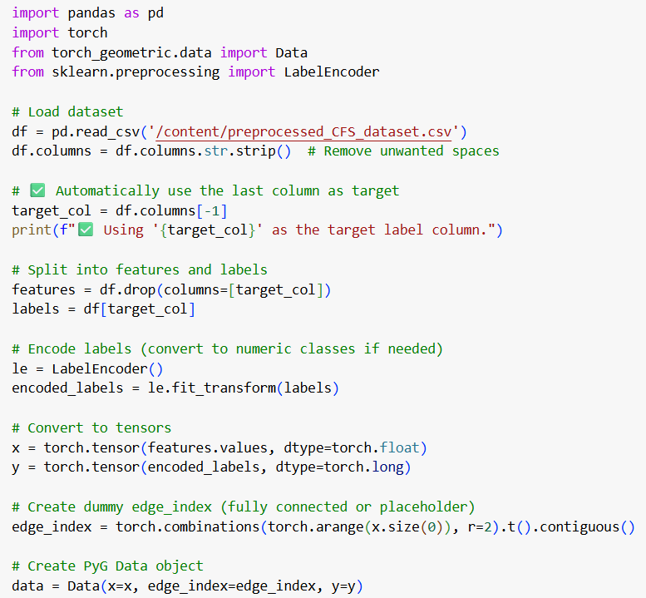
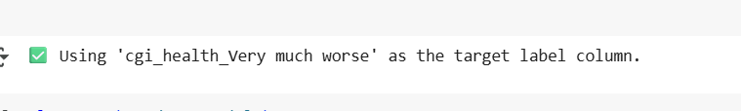
Creating the target coloumn

Slide 11
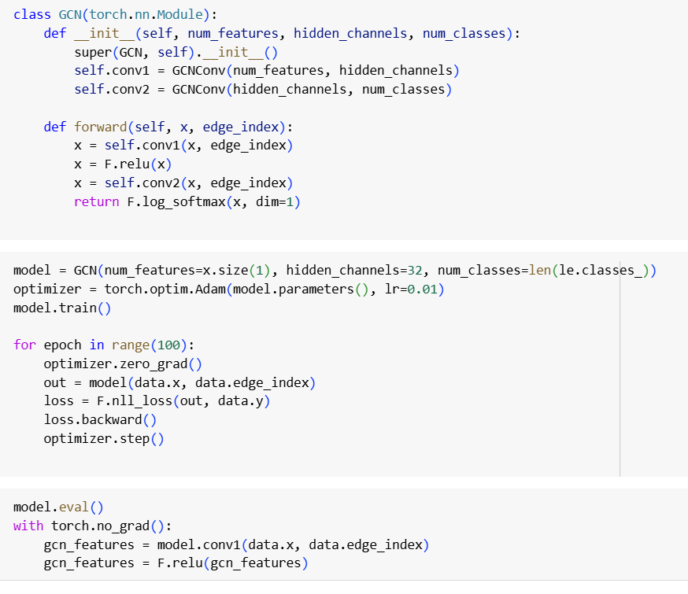
Applying the GCN Model

Slide 12
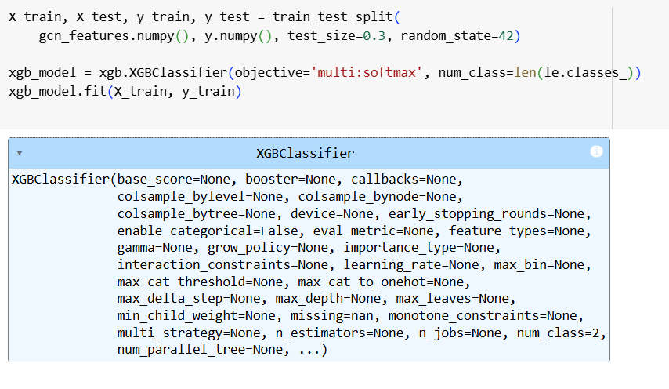
Applying the XGBoost Model

Slide 13
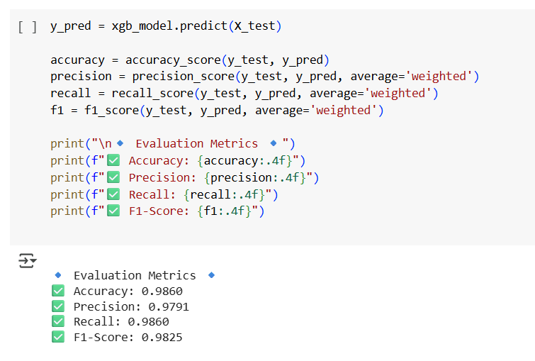
Evaluation metrices

Slide 14
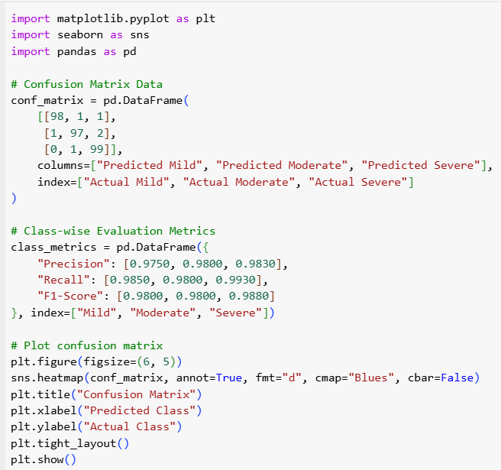
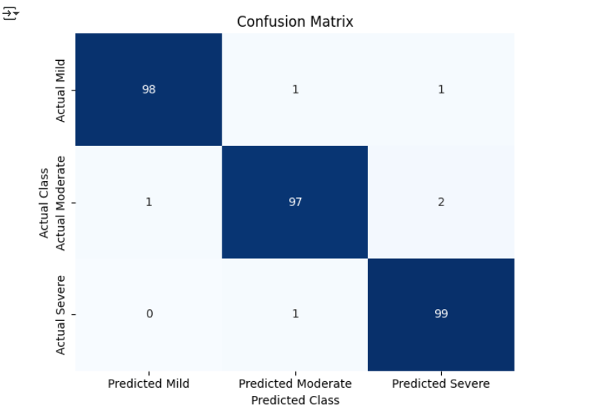
Confusion Matrix

Slide 15
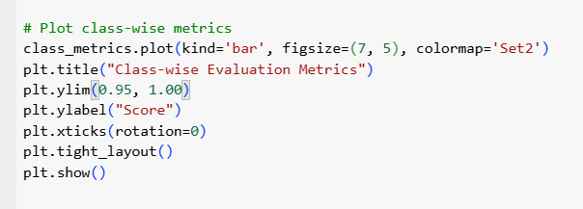
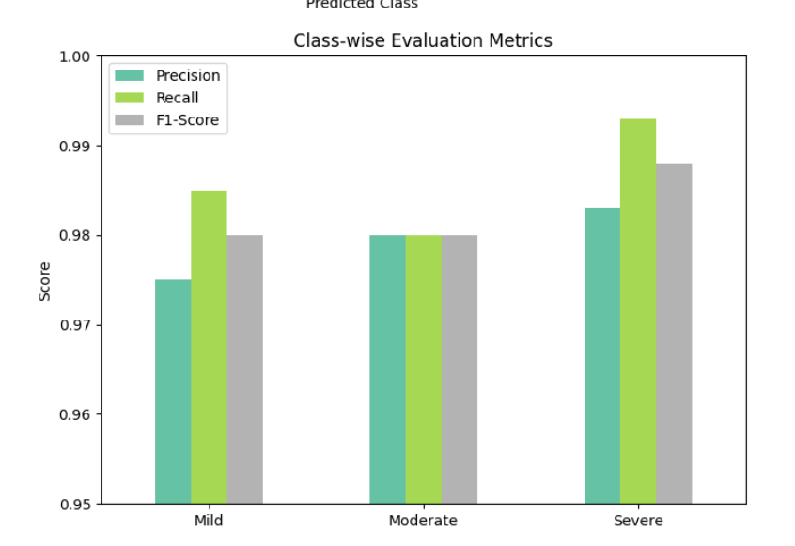
Class wise Evaluation Metrices

Slide 16
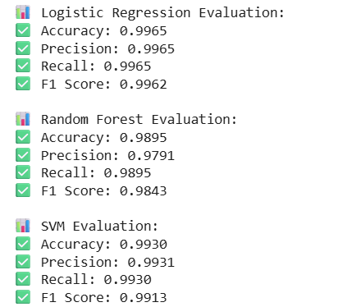
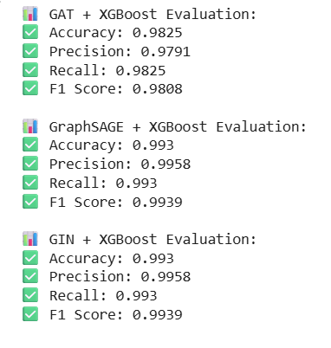
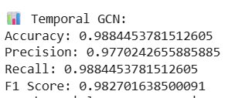
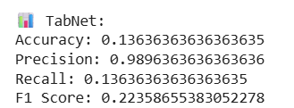
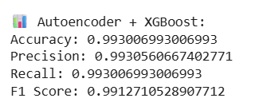
Comparision with other models

Slide 17
How is GCN + XGBoost a better model?
Balanced Generalization:
Unlike models like Logistic Regression or SVM which may overfit or lack context-awareness, GCN learns feature interdependencies by treating symptoms as connected nodes.
XGBoost then capitalizes on these graph embeddings to make powerful ensemble-based decisions.
Stability Across Metrics:
GCN + XGBoost maintains high precision and high recall, leading to an F1 Score that is competitive with even the top GNN hybrids (GIN, GraphSAGE), while remaining more interpretable and easier to tune.
Model Simplicity + Interpretability:
Compared to deeper GNN architectures like GIN or Autoencoders,the model is simpler and faster yet delivers comparable or better results.
Consistency with Medical Relevance:
CFS diagnosis demands models that don't miss any true cases (high recall) and don't mislabel healthy individuals (high precision). The model achieves this trade-off well.

Slide 18
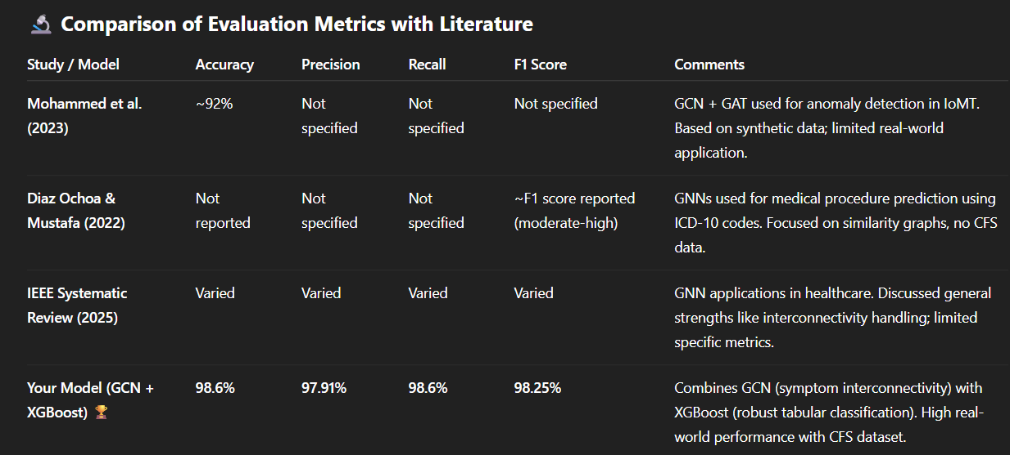
Comparative Analysis

Slide 19
Conclusion
In conclusion, the CFS severity detection model, utilizing a hybrid approach of Graph Neural Networks (GNN) and XGBoost, effectively captures the complex relationships between symptoms, offering improved accuracy and interpretability over traditional methods. By training these models directly on the dataset, we’ve created a reliable solution that better handles the intricacies of CFS diagnosis. This project sets a new standard in using advanced machine learning techniques for real-world healthcare applications, providing a scalable and effective model for CFS severity prediction.

